Slide 1
Finding hotel location in London
Hao Vu T

Slide 2
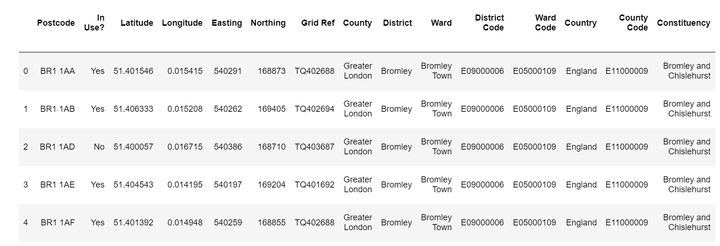
The London's Districts, Wards
The London's Districts, Wards data included theirs location I get from https://www.doogal.co.uk/london_postcodes.php. In this website they provide many more data features as well.

Slide 3
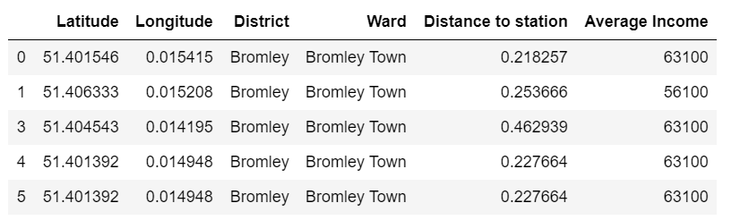
The London's Districts, Wards
Only get useful columns

Slide 4
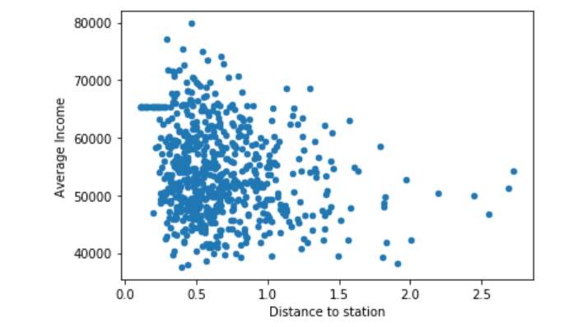
Distance to Station Vs Average Income
The plot show the impact of Distance to Station to Average Income. I found that the closer to station the higher income, but highest income in range 0.5 miles to the stations.

Slide 5
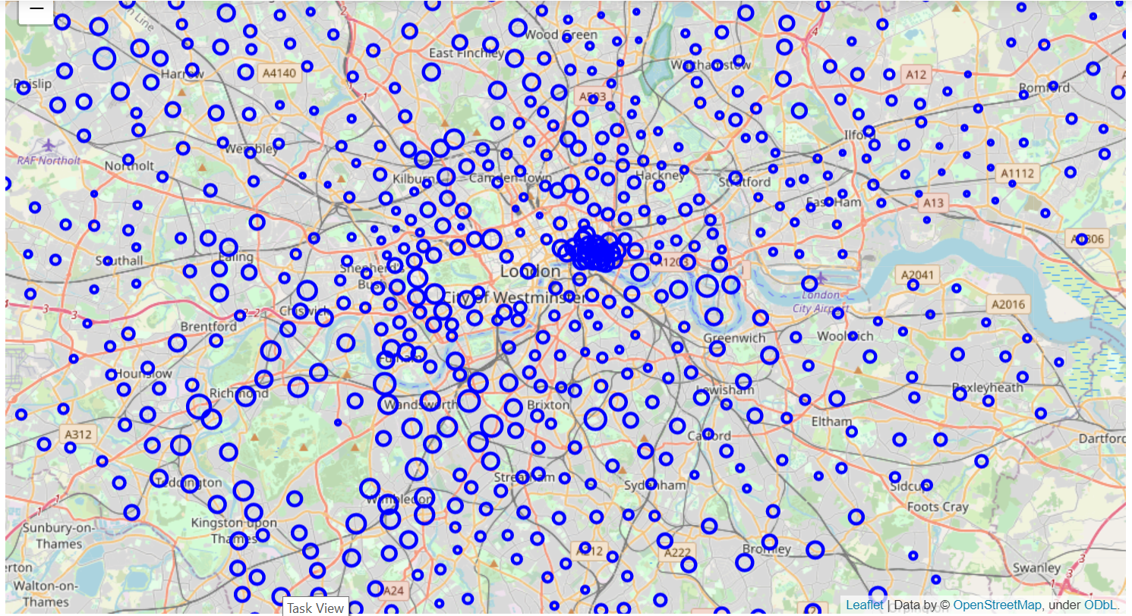
Map of neighborhoods of London city
I using Folium map to display all neighborhoods of London city. The bigger circles the higher average income.

Slide 6
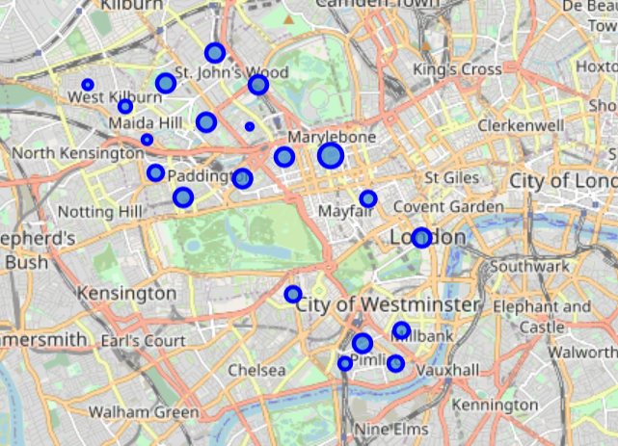
focus in Westminster only to minimize the data

Slide 7
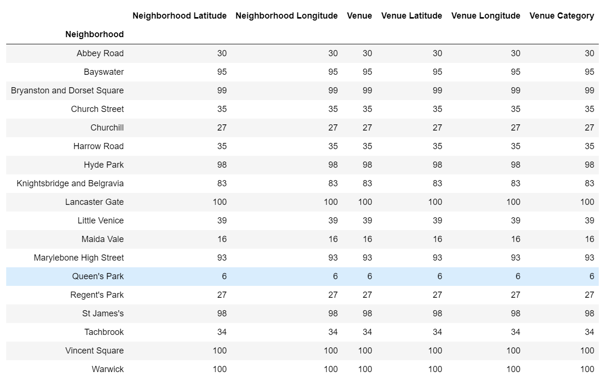
using Foursquare to find venues in Westminster, group by each neighborhood

Slide 8
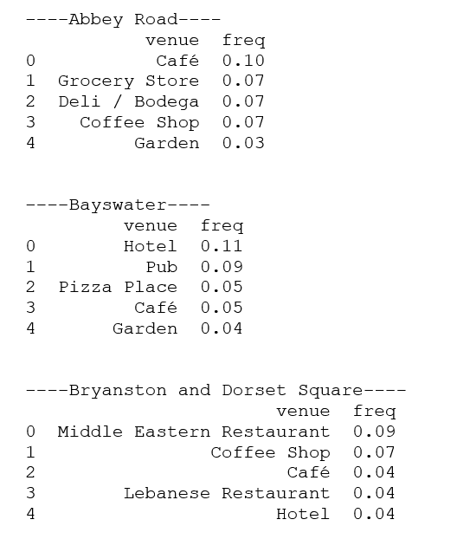
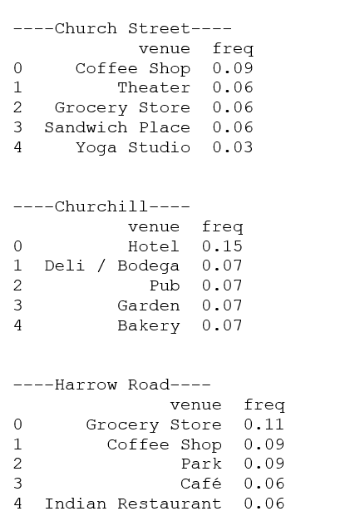
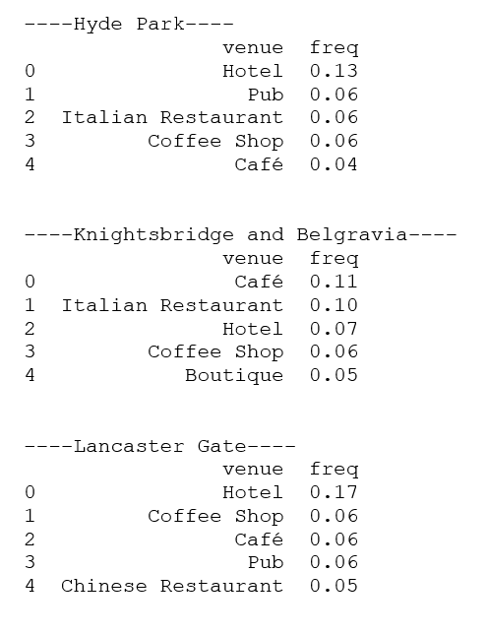
The most frequent venue types in each neighborhood

Slide 9
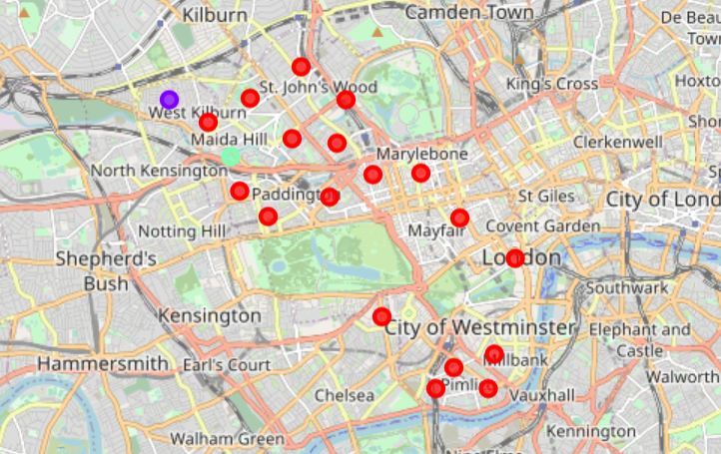
Clustering neighborhoods
Using K-mean to clustering neighborhood due to theirs similarities then visualize the resulting clusters.

Slide 10
REsults
To find the places for hotel, I find the neighborhood with no hotel in top 5 categories. The following are candidate places.
----Westbourne----
venue freq
0 Pub 0.25
1 Gym / Fitness Center 0.12
2 Bus Station 0.06
3 Convenience Store 0.06
4 Gastropub 0.06
----Church Street----
venue freq
0 Coffee Shop 0.09
1 Theater 0.06
2 Grocery Store 0.06
3 Sandwich Place 0.06
4 Yoga Studio 0.03
----Harrow Road----
venue freq
0 Grocery Store 0.11
1 Coffee Shop 0.09
2 Park 0.09
3 Café 0.06
4 Indian Restaurant 0.06
----Little Venice----
venue freq
0 Pub 0.15
1 Café 0.13
2 Coffee Shop 0.05
3 Lebanese Restaurant 0.05
4 Pizza Place 0.03
----Maida Vale----
venue freq
0 Deli / Bodega 0.12
1 Thai Restaurant 0.12
2 Coffee Shop 0.12
3 Japanese Restaurant 0.06
4 Wine Shop 0.06
----West End----
venue freq
0 Clothing Store 0.12
1 Boutique 0.05
2 Cosmetics Shop 0.04
3 Indian Restaurant 0.03
4 Coffee Shop 0.03

Slide 11
Thank you!

